Slide 1




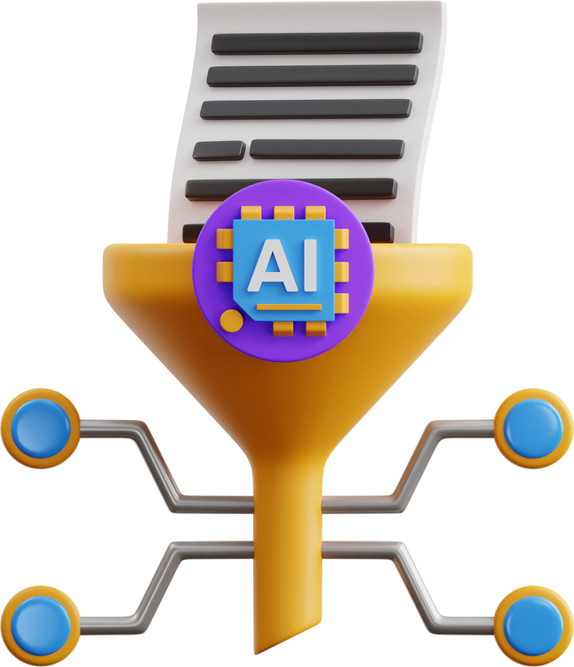
Enhancing the Access Privacy of IDaaS System using SAML Protocol in Fog Computing
Rupa Ch
Rizwan Patan
Fadi Al-Turjman
Leonardo Mostarda
Khalid Redwan Sun
ID - 20301281
Course- CSE449
BRAC University
1

Slide 2
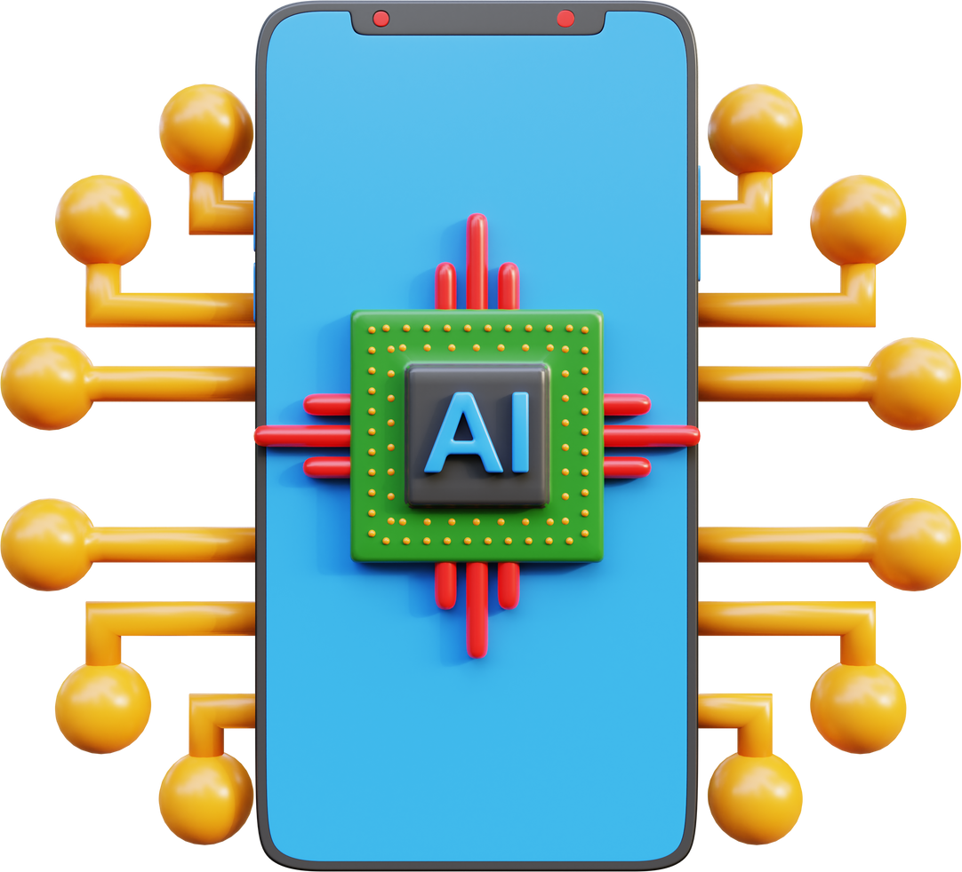
Introduction
Explore SAML protocol for enhancing access privacy in IDaaS system in fog computing.
Unique challenges for identity and access management
SAML protocol's capabilities in providing secure authentication and authorization
Contribution to the discourse on privacy and security in cloud and fog computing
2

Slide 3
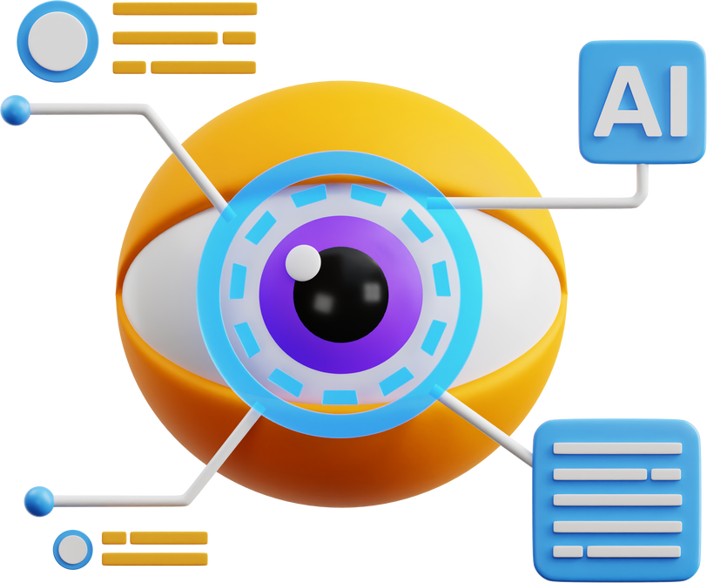

Methodology
System Design
Implementation
Evaluation
3

Slide 4
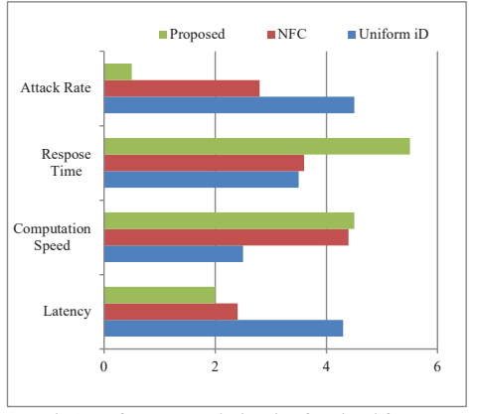
Results
Fig 1 : Performance Analysis using functional factors
4

Slide 5
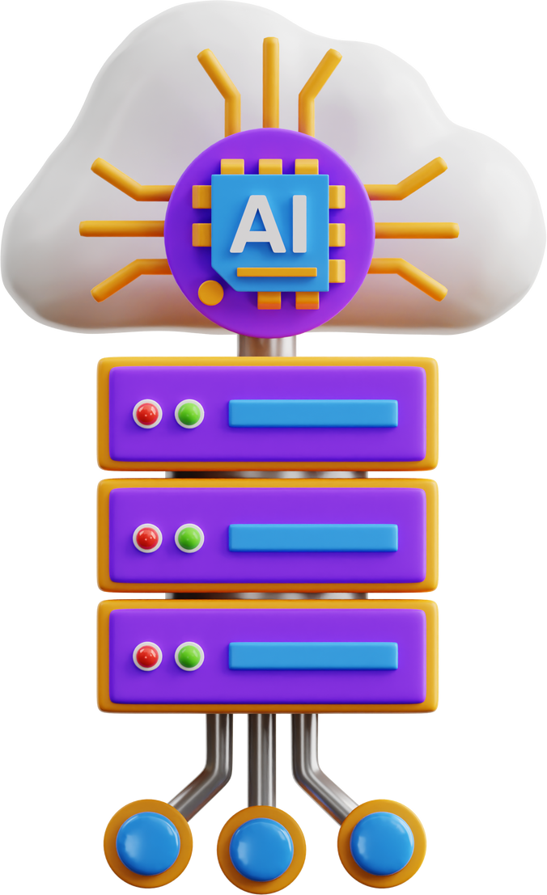
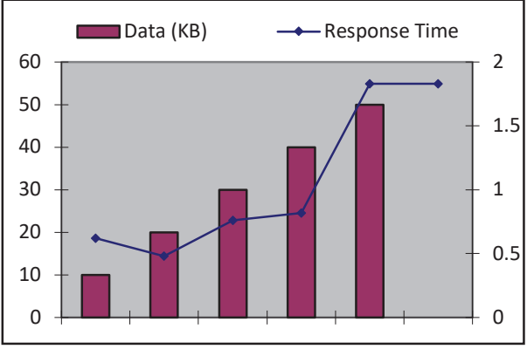
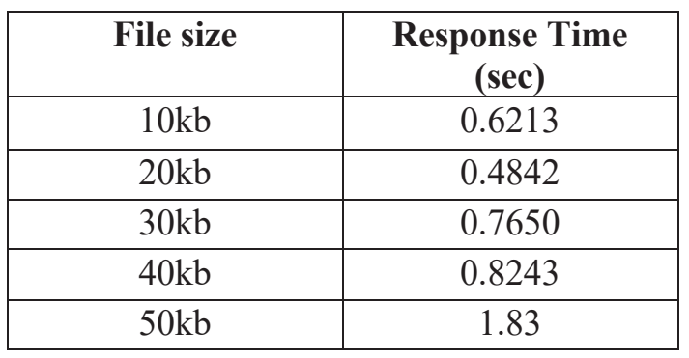
Results
Fig 2 : Response time for corresponding Data Computation
Table 1 : Response time based Analysis
5

Slide 6
Limitations
01
02
03
SAML protocol and may not capture all possible scenarios.
Limited real-world deployment and testing of the SAML protocol
did not address the potential performance implications of implementing the SAML protocol
6

Slide 7

CONCLUSION
effectiveness of using the SAML protocol
privacy and security of identity and access management
providing a valuable framework for enhancing access privacy
7
Future research & exploration

Slide 8
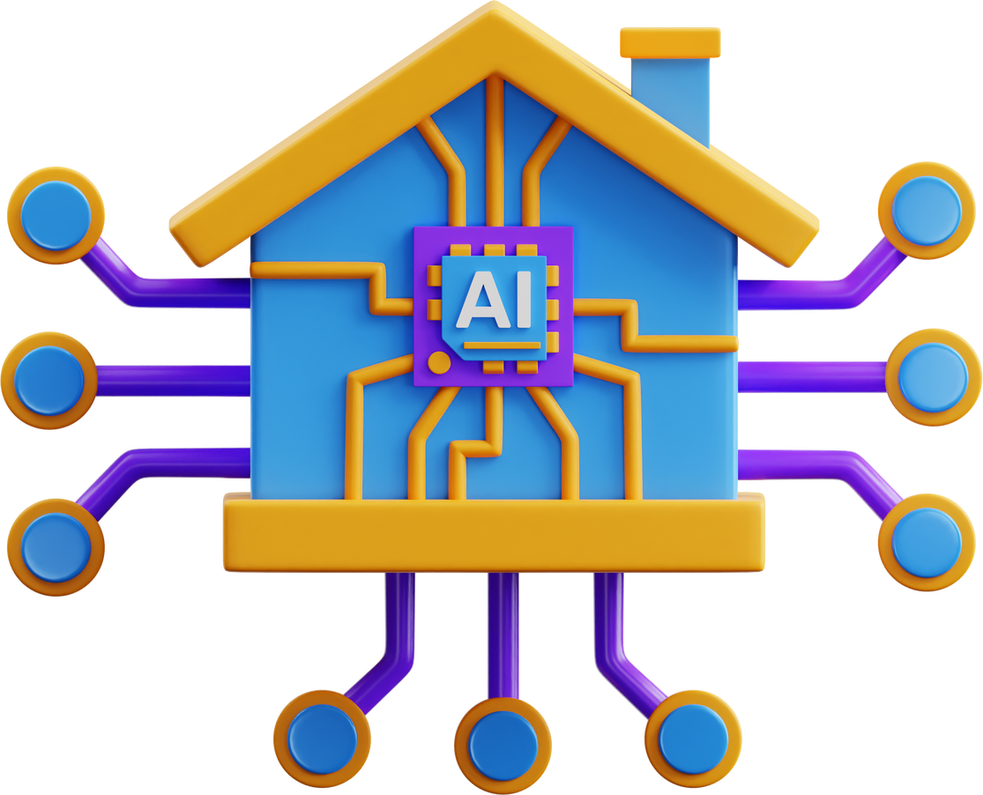
Thank You!

